Slide 1



REINFORCE MILLENIAL IDEAS
2101626626 – Jonathan Sebastian P.
2101628594 – Nicholas Dominic
2101628650 – Arvin Melvillo
2101634911 – Daniel
2101655020 – Andrian Syah Putra L.

Slide 2
MOTIVE works as container for any groups who have business idea but have difficulties in development due to lack of funds and adequate human resources.

Slide 3
OUR CONCERN
This start-up was initiated in early 2019 by five Bina Nusantara (BINUS) University students. We decided to create this platform because our concern looking about students' bright ideas while working on BINUS Entrepreneurship tasks only ended in grades and it wasn’t fully realized, where may the idea had a great potential to create jobs and advance Indonesia economy.

Slide 5

COMPANY
PROFILE

Slide 6
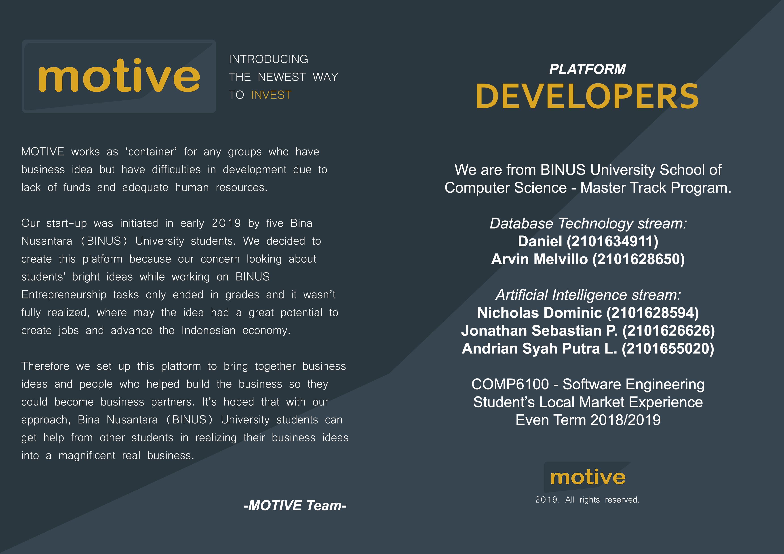
COMPANY
PROFILE

Slide 7
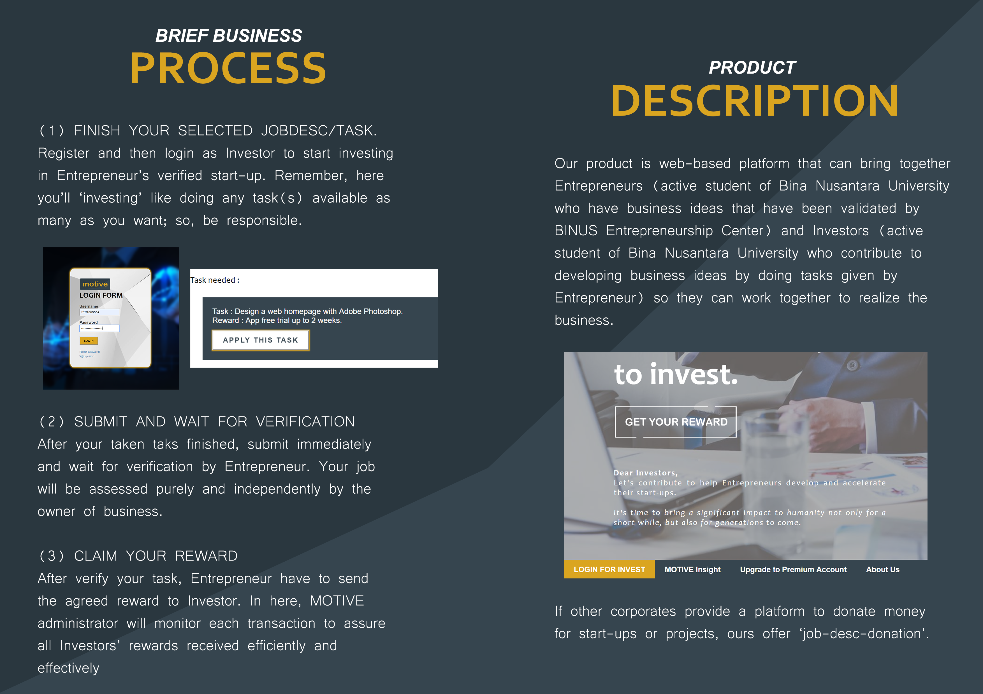
COMPANY
PROFILE

Slide 8
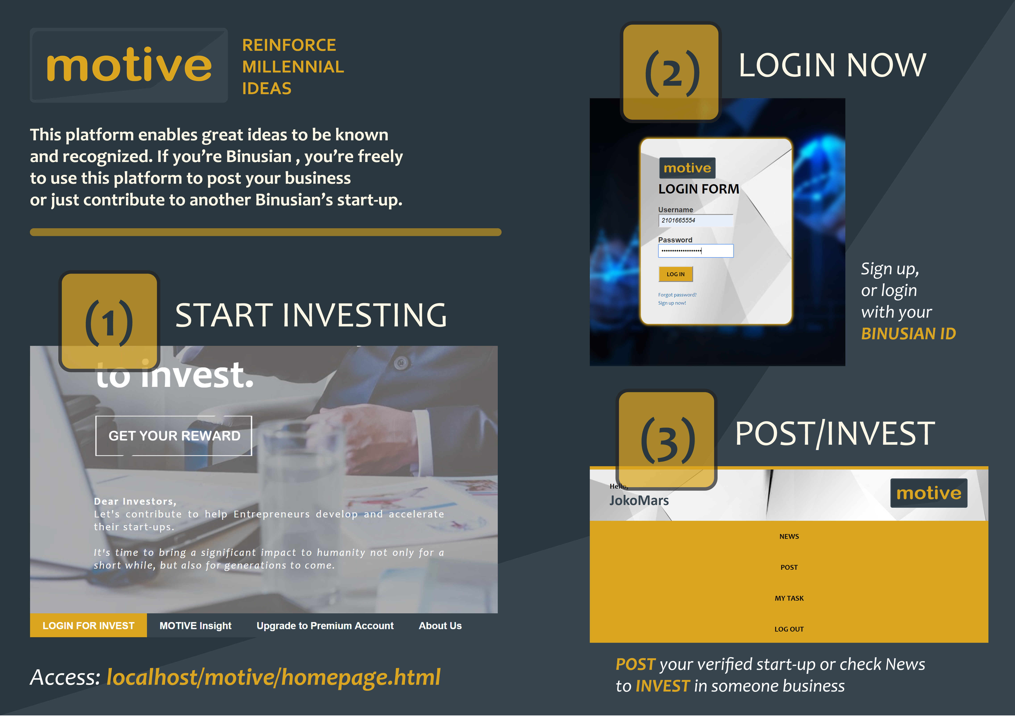
CATALOGUE

Slide 9
BANNER

Slide 10



Slide 11


Slide 12



Slide 13
Thanks!
Any questions?

